Slide 1
Introduction to Windows Server
IOS110

Slide 2
Objectives
Define a Server versus a Client/Workstation
Identify the key features and appropriate use of each Windows Server 2012 R2 edition
Describe the hardware requirements for Windows Server 2012 R2
Identify technologies supported by Windows Server 2012 R2

Slide 3
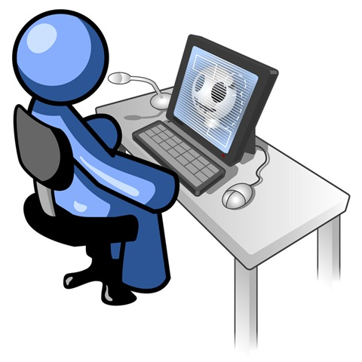
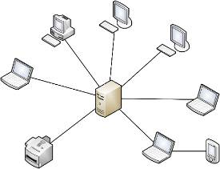
What is a Server Operating System?
Server Operating System
Desktop Operating System
provides services to users and client computers on a network and are typically optimized to perform these tasks
optimized to interact with users and run user applications
Notes:
Although a small server might look no different from a high-end desktop PC, the machines are designed for very different tasks. A desktop computer is designed for one person who needs a user-friendly operating system to run desktop applications such as a word processor, a spreadsheet, an email client, and a Web browser. A server runs a specialized operating system designed to support many users. It’s engineered to run multiuser applications such as email, messaging, and print servers; shared calendar programs; databases; and enterprise resource planning and customer relationship management software.
A server also makes it easy for your employees to share data and collaborate, since it operates as a central repository for all of your documents, images, contacts, and other important files. It can host a company intranet, for sharing information with your employees quickly and economically. Set up a virtual private network, and you and your employees can access the data on the server remotely from anywhere you have Internet access. On top of that, a server can automatically back up your desktop and laptop systems, so you’ll never lose critical data if one machine fails or is lost or stolen. Servers are designed to be reliable, secure, and fault-tolerant, with redundant storage options. If you expect your business to expand, choose a server that’s scalable and can grow with you.

Slide 4
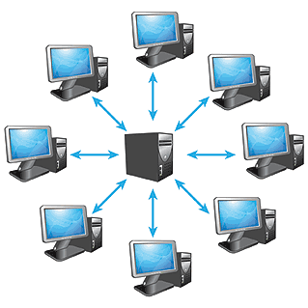
Server Operating System Services
Web services
Email services
File storage
Print services
Shared applications
Client/server applications
Unattended installations
User management
Resource management
Network management

Slide 5
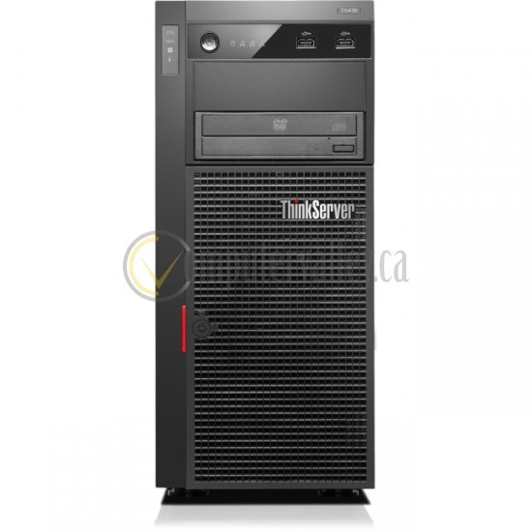
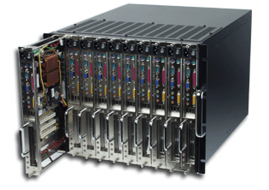
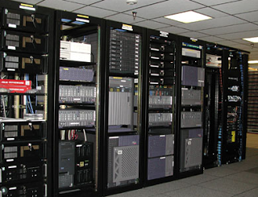
Server Hardware
Blade and Rack Mounted Servers
Small Business Server
Notes:
http://datacenterpost.com/2013/03/what-is-difference-between-rack-and.html

Slide 6
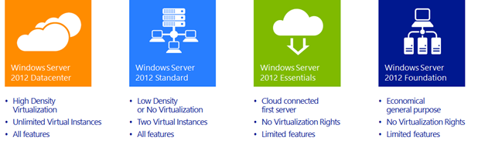
Windows Server 2012 R2 Editions
Windows Server 2012 R2 Datacenter Edition
Windows Server 2012 R2 Standard Edition
Windows Server 2012 R2 Essentials Edition
Windows Server 2012 R2 Foundation Edition

Slide 7
Windows Server 2012 R2 Datacenter and Standard Editions
Datacenter edition for highly-virtualized private cloud environments (unlimited VMs)
Only available through volume licensing and OEM channels.
Standard edition for non-virtualized or lightly virtualized environments (only 2 VMs)
Available through OEM, volume licensing, and retail channels
Notes:
The Windows Server 2012 R2 Standard edition of windows server is used for medium to large businesses that require additional features not present in the Foundation & Essential edition. The Standard edition is able to support an unlimited amount of users, as long as the required user licenses have been purchased.
Advanced features such as certificate services role, Hyper V, RODC (Read Only Domain Controller), IPAM (IP Address Management), Data deduplication, server core, failover clustering and more, are available to Windows Server 2012 Standard edition. We should note that the Standard edition supports up to 2 Virtual Machines running Windows Server 2012. **You can have more than 2 VMs, but past 2, the other VMs would either require additional licenses to be purchased for Windows Server, or you could run free Linux distributions (or other licensed or free OSs).
The Windows Server 2012 R2 Datacenter edition is the flagship product created to meet the needs of medium to large enterprises. The major difference between the Standard and Datacenter edition is that the Datacenter edition allows the creation of unlimited Virtual Machines and is therefore suitable for environments with extensive use of virtualization technology.

Slide 8
Windows Server 2012 R2 Datacenter and Standard Editions
Full set of server features
enterprise-class server and cloud platform
powerful availability features protect against service outages
automation plus storage and networking virtualization solutions
Per-processor licensing (2 processors/license)
requires Windows Server CALs for every user or device accessing a server

Slide 9
Windows Server 2012 R2 Essentials Edition
for small businesses with up to 25 users running on servers with up to two processors
Limited set of features
Available through OEM, volume licensing, and retail channels
1 license covers 2 processors and 25 users
Cannot join a domain (can create a domain)
No Server Core Mode
Notes:
The Windows Server 2012 R2 Essentials edition is the next step up, also geared towards small businesses of up to 25 users. Windows Server 2012 R2 Essentials edition is available in retail stores around the world making it easy for businesses to install the new operating system without necessarily purchasing new hardware. Similar to the Foundation edition, the Essentials edition does not support many advanced server features, however it does provide support of features like Hyper V, dynamic memory and hot add/remove RAM.
Windows Server 2012 R2 Essentials edition can run a single instance of virtual machine on Hyper V, a feature that was not available in Windows Server 2012 Essentials (non-R2) edition. This single virtual machine instance can be Windows Server 2012 R2 Essential edition only, seriously limiting the virtualization options but allowing companies to begin exploring the benefits of the virtualization platform.

Slide 10
Windows Server 2012 R2 Foundation Edition
for small businesses with up to 15 users running on single processor servers
Limited set of features
Only available pre-installed on servers through OEM channels
1 license covers 1 processor and 15 users
Cannot join a domain (Can create a domain)
No Server Core Mode
Notes:
This edition of Windows Server 2012 R2 is targeted towards small businesses of up to 15 users. The Windows Server 2012 R2 Foundation edition comes pre-installed on hardware server with single physical processor and up to 32GB of DRAM memory. Foundation edition can be implemented in environments where features such as file sharing, printer sharing, security and remote access are required. Advanced server features such as Hyper V, RODC (Read Only Domain Controller), data deduplication, dynamic memory, IPAM (IP Address Management), server core, certificate service role, hot add memory, windows update services and failover clustering are not available in the Foundation edition.

Slide 11
Hardware Requirements
Minimum Requirements
Actual Requirements:
CPU - 1.4 GHz (x64)
Disk Space - 32 GB
RAM - 512 MB
Gigabit (10/100/1000baseT) Ethernet adapter
DVD (if installing from DVD media)
Super VGA or better display
keyboard and pointing device
will vary based on your system configuration, expected load on the server and the applications and features you install.
Notes:
The highly diverse scope of potential deployments makes it unrealistic to state “recommended” system requirements that would be generally applicable. Consult documentation for each of the server roles you intend to deploy for more details about the resource needs of particular server roles. For the best results, conduct test deployments to determine appropriate system requirements for your particular deployment scenarios.
Be aware that 32 GB HD space should be considered an absolute minimum value for successful installation. This minimum should allow you to install Windows Server 2012 R2 in Server Core mode, with the Web Services (IIS) server role. A server in Server Core mode is about 4 GB smaller than the same server in Server with a GUI mode. For the smallest possible installation footprint, start with a Server Core installation and then completely remove any server roles or features you do not need by using Features on Demand. For more information about Server Core and Minimal Server Interface modes, see Windows Server Installation Options.
The system partition will need extra space for any of the following circumstances:
If you install the system over a network.
Computers with more than 16 GB of RAM will require more disk space for paging, hibernation, and dump files.
If you create a virtual machine with the minimum supported hardware parameters (1 processor core and 512 MB RAM) and then attempt to install this release on the virtual machine, Setup will fail.
To avoid this, do one of the following:
Allocate more than 800 MB RAM to the virtual machine you intend to install this release on. Once Setup has completed, you can change the allocation to as little as 512 MB RAM, depending on the actual server configuration.

Slide 12
Hardware Maximums
Memory/RAM
Processors
Standard/Datacenter 4TB
Essentials 64GB
Foundation 32GB
Standard/Datacenter 64
Essentials 2
Foundation 1

Slide 13
Windows Server 2012 R2 Features
Server Manager/Remote Administration
Clustering
Reliability (Hot-Add/Replace Memory and Processors)
Windows Server Core
Windows PowerShell
Virtualization
Cloud Computing
Mobile Support

Slide 14
Server Manager
Server Manager is a management console in Windows Server® 2012 that helps IT professionals provision and manage both local and remote Windows-based servers from their desktops, without requiring either physical access to servers, or the need to enable Remote Desktop protocol (RDP) connections to each server.
Notes:
http://blogs.technet.com/b/askpfeplat/archive/2012/08/21/welcome-to-server-manager-2012-style.aspx

Slide 15
Server Manager
Manage Local and Remote servers
View and change server configuration
View and change network configuration
Add and Remove Server Roles and Features
Run diagnostics
Manage storage and backups

Slide 16
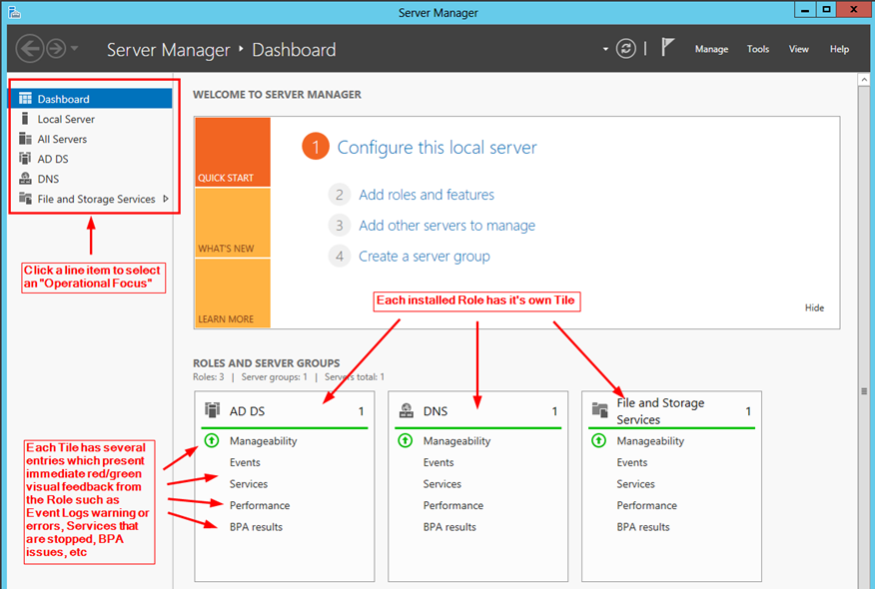
Server Manager
Notes:
http://technet.microsoft.com/en-us/library/jj134147.aspx

Slide 17
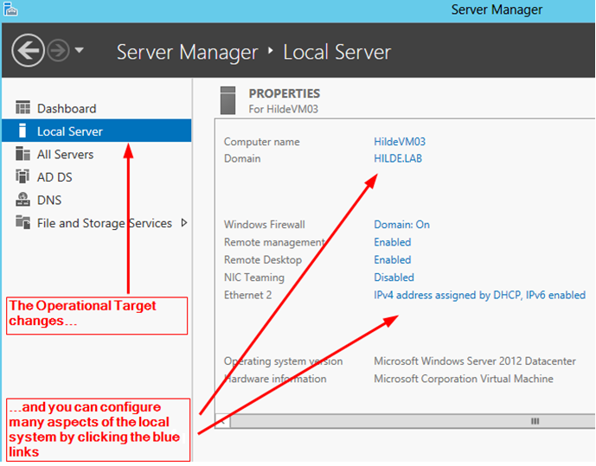
Manage the Local Server
http://blogs.technet.com/b/askpfeplat/archive/2012/08/21/welcome-to-server-manager-2012-style.aspx

Slide 18
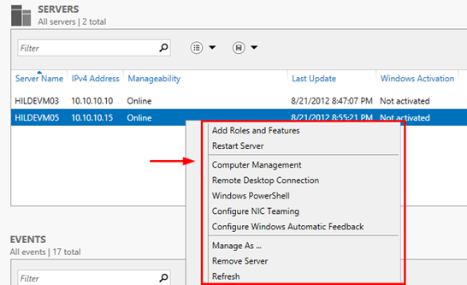
Manage Remote Server(s)
http://blogs.technet.com/b/askpfeplat/archive/2012/08/21/welcome-to-server-manager-2012-style.aspx

Slide 19
Clustering
Links two or more servers (nodes) so they appear to function as though they are one
Increases access to server resources and provides fail-safe services with fail-over technology
Increases computer speed to complete server tasks faster by combining processing power and memory
Notes:
http://technet.microsoft.com/en-us/library/hh831579.aspx
A failover cluster is a group of independent computers that work together to increase the availability and scalability of clustered roles (formerly called clustered applications and services). The clustered servers (called nodes) are connected by physical cables and by software. If one or more of the cluster nodes fail, other nodes begin to provide service (a process known as failover). In addition, the clustered roles are proactively monitored to verify that they are working properly. If they are not working, they are restarted or moved to another node. Failover clusters also provide Cluster Shared Volume (CSV) functionality that provides a consistent, distributed namespace that clustered roles can use to access shared storage from all nodes. With the Failover Clustering feature, users experience a minimum of disruptions in service.
http://technet.microsoft.com/en-us/library/cc785197%28v=ws.10%29.aspx
The ability to handle failure allows server clusters to meet requirements for high availability, which is the ability to provide users with access to a service for a high percentage of time while reducing unscheduled outages.
In a server cluster, each server owns and manages its local devices and has a copy of the operating system and the applications or services that the cluster is managing. Devices common to the cluster, such as disks in common disk arrays and the connection media for accessing those disks, are owned and managed by only one server at a time. For most server clusters, the application data is stored on disks in one of the common disk arrays, and this data is accessible only to the server that currently owns the corresponding application or service.
Server clusters are designed so that the servers in the cluster work together to protect data, keep applications and services running after failure on one of the servers, and maintain consistency of the cluster configuration over time

Slide 20
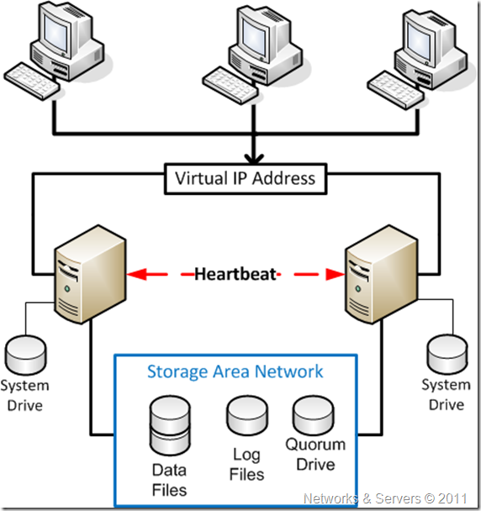
Clustering
http://networksandservers.blogspot.ca/2011/04/failover-clustering-i.html

Slide 21
Hot-Add/Replace
Hot-add processor
Can be added to an empty processor slot while the system is running
Hot-replace processor
Can replace a processor in an SMP system without taking the system down
Hot-add memory
allows ranges of physical memory to be added to a running operating system without requiring a system reboot
Notes:
Hot=with power

Slide 22
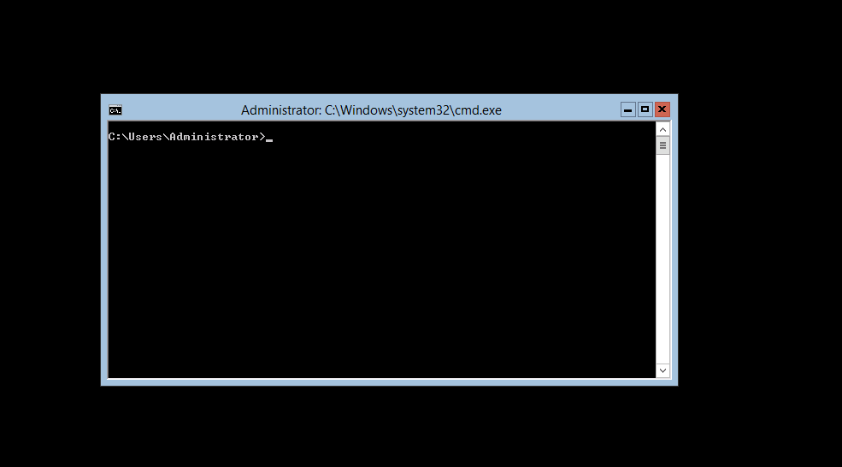
Windows Server Core
minimal server configuration
no Windows shell and very limited GUI functionality
interface is a command prompt with PowerShell support
Notes:
https://4sysops.com/archives/windows-server-2012-server-core-part-1-benefits/

Slide 23
Benefits of Server Core
Reduced Servicing
Server Core installs only what is required for a manageable DHCP, File, DNS, Media Services, and Active Directory server, therefore less servicing is required.
Reduced Management
less is installed on a Server Core-based server, therefore less management is required.
Reduced attack surface
less running on the server, therefore less attack surface
Reduced Resource Requirements
disk space and memory

Slide 24
Changing from Server Core to GUI
In previous versions of Windows Server, once Server Core was installed, the only way to get a GUI interface was to reinstall.
With Windows Server 2012 and R2, you can move back and forth between Server Core and the GUI by adding and removing Roles and Features through the Server Manager

Slide 25
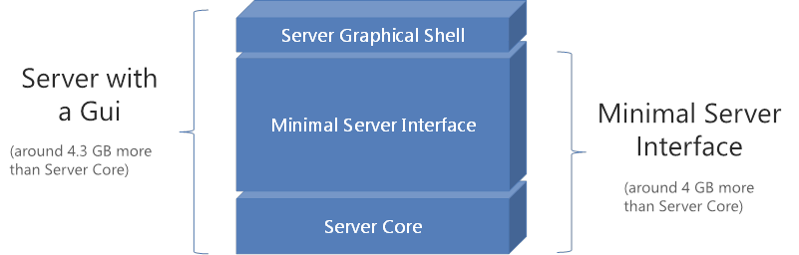
Something In-Between
For servers where you don’t want to give up all of the GUI conveniences, you can install:
Minimal Server Interface
Notes:
http://blog.thesysadmins.co.uk/server-2012-moving-between-gui-core-and-minimal-server-interface.html

Slide 26
Windows PowerShell
Full-featured command shell that can use:
built-in commands, called cmdlets
built-in programming features
Standard command line utilities
Any configuration or management task that can be done through a GUI tool, can also be accomplished with PowerShell
Scripts can be written to automate tasks

Slide 27
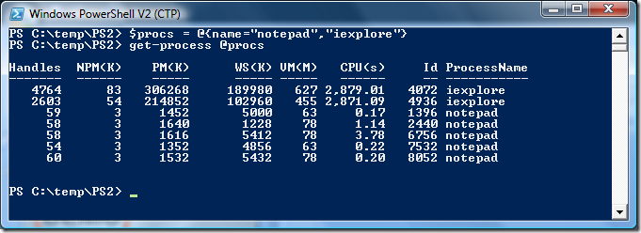
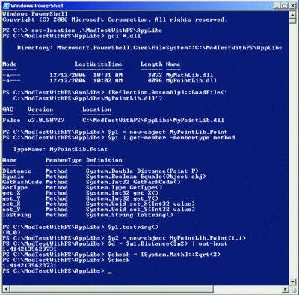
Windows PowerShell

Slide 28
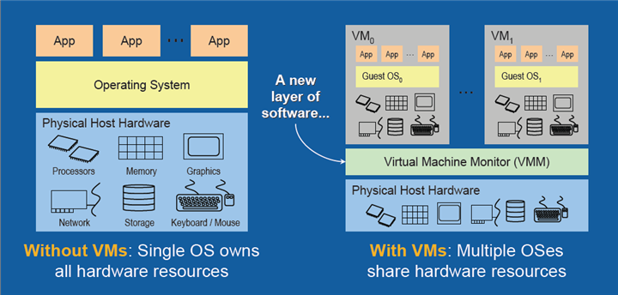
Virtualization
a combination of software and hardware engineering that creates Virtual Machines (VMs) - an abstraction of the computer hardware that allows a single machine to act as if it where many
Notes:
https://software.intel.com/en-us/articles/the-advantages-of-using-virtualization-technology-in-the-enterprise

Slide 29
Virtual Machines (Servers)
Enables server consolidation and uses resources more efficiently
reduce power consumption and air conditioning needs
Reduce building space and land requirements
provides high availability for critical applications, and streamlines application deployment and migrations.
can simplify IT operations and allow IT organizations to respond faster to changing business demands

Slide 30
Hyper-V
Microsoft’s Server Virtualization software, included with Standard and Datacenter
Hyper-V is free software that can be downloaded from the Microsoft website.
Install the Hyper-V role and use the Hyper-V Manager to create and manage virtual machines
You can use other companys’ virtualization software with Windows server

Slide 31
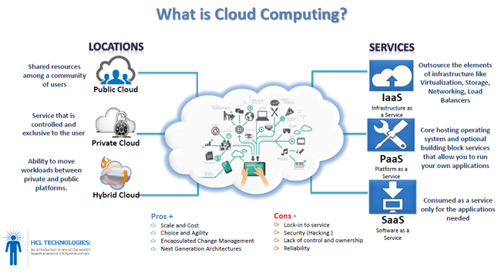
Cloud Computing
http://www.hcltech.com/blogs/transformation-through-technology/rise-cloud/
Notes:
http://www.microsoft.com/enterprise/microsoftcloud/default.aspx#fbid=7Esbz-2qdbd
http://www.explainthatstuff.com/cloud-computing-introduction.html
What is cloud computing?
Cloud computing means that instead of all the computer hardware and software you're using sitting on your desktop, or somewhere inside your company's network, it's provided for you as a service by another company and accessed over the Internet, usually in a completely seamless way. Exactly where the hardware and software is located and how it all works doesn't matter to you, the user—it's just somewhere up in the nebulous "cloud" that the Internet represents.
Cloud computing is a buzzword that means different things to different people. For some, it's just another way of describing IT (information technology) "outsourcing"; others use it to mean any computing service provided over the Internet or a similar network; and some define it as any bought-in computer service you use that sits outside your firewall. However we define cloud computing, there's no doubt it makes most sense when we stop talking about abstract definitions and look at some simple, real examples—so let's do just that.

Slide 32
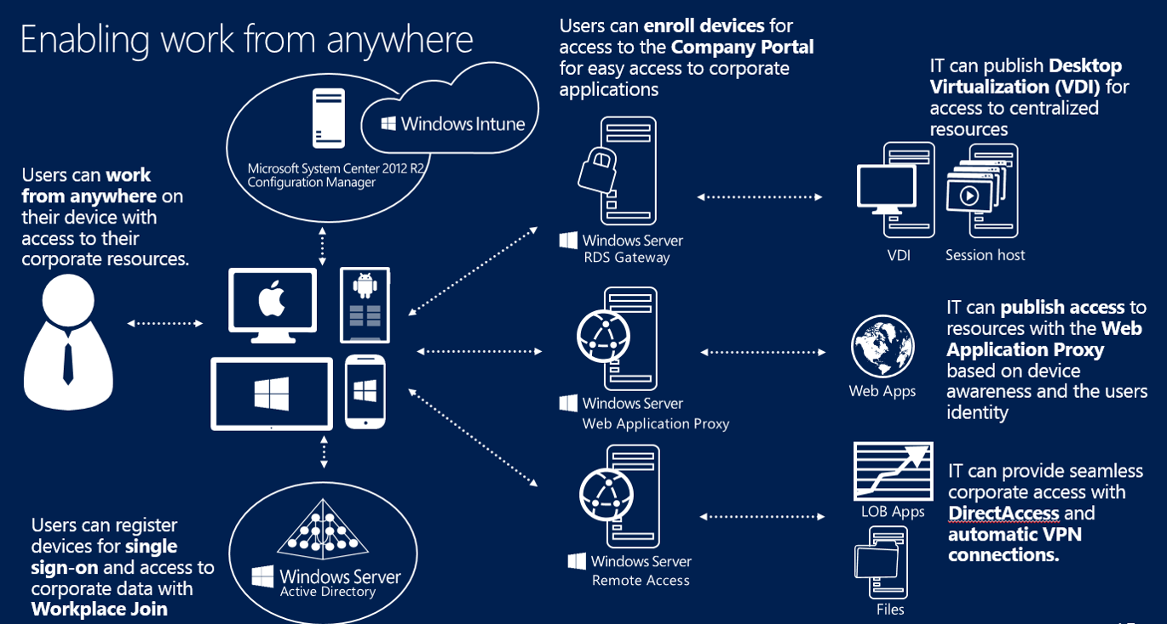
Mobile Device Support – Workplace Join
http://blogs.technet.com/b/itprohellas/archive/2014/03/03/what-s-new-in-server-2012-r2-part-6-access-and-information-protection.aspx
Notes:
BYOD – Bring Your Own Device
http://blogs.technet.com/b/keithmayer/archive/2013/11/09/why-r2-step-by-step-solve-byod-challenges-with-workplace-join.aspx
https://4sysops.com/archives/workplace-join-overview/
These days, users are growing more and more accustomed to expecting that they can accomplish productive work from anywhere, at any time, and on any device. As a result, IT Pros and organizations are increasingly faced with the challenge of balancing convenience with security to provide users with the necessary remote access to corporate applications and services that was previously available only from corporate-managed Active Directory Domain-Joined PC’s. As one method of addressing this growing need, Windows Server 2012 R2 and Windows 8.1 provide a new BYOD management feature that lots of IT Pros have been excited about: Workplace Join. In addition, Workplace Join is also supported for Apple iOS mobile devices.
What is Workplace Join?
With Workplace Join, users can remotely register a non-Domain Joined device in Active Directory (AD) to gain secure “single sign-on” access to permitted corporate network resources from a BYOD, or Bring Your Own Device, PC. The Workplace Join process creates a new device object in AD and also installs a certificate on the device. Once Workplace Join is completed for a device, IT Pros can leverage the user’s device authentication as part of a set of conditional access policies to permit access to only authorized network applications and services. These conditional access policies can be used to provide appropriate access to users when accessing resources from a Workplace Joined device versus a fully Domain Joined device.

Slide 33
Summary
The Windows Server 2012 R2 platforms include, Standard Edition, Datacenter Edition, Essentials Edition and Foundation Edition
Windows Server 2012 R2 includes many vital features, including: Server Manager/Remote Administration, Clustering, Reliability, Windows Server Core, Windows PowerShell, Virtualization, Cloud Computing and Mobile Support

